Slide 1

INFS 791 Project
Yifei Gao, Kara Lee, Scarlett Winters

Slide 2
INFS 791 Project
1
Data Overview
2
Developing User Interface
3
Area for Improvement
4

Slide 3
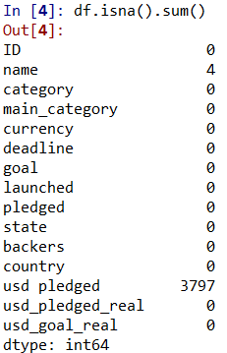
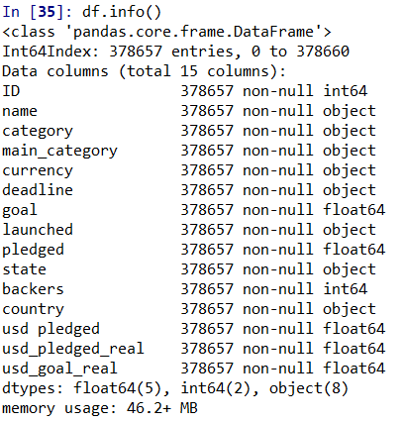
Data Overview
The data we used for this project was pulled from Kaggle and it features information from Kickstarter on projects that were launched from 2009 to 2018.
The data contains 15 columns and over 65,000 rows
We explored the data with Python, dropped the NAs in ‘name’ and filled the NAs in ‘usd_pledged’ with ‘0’.
Since most of data was continuous, we created columns to bin some of the data we wanted to analyze.
Notes:
If we want,

Slide 4

Data Overview
The focus of our data is to see which projects were successful:
Factors for our code included:
Main_Category of Project (i.e. comics, music, film)
Funding Goal Size (i.e how much money they are trying to raise)
Amount of Backers
Year of Project
Season
Notes:
If we want,

Slide 5
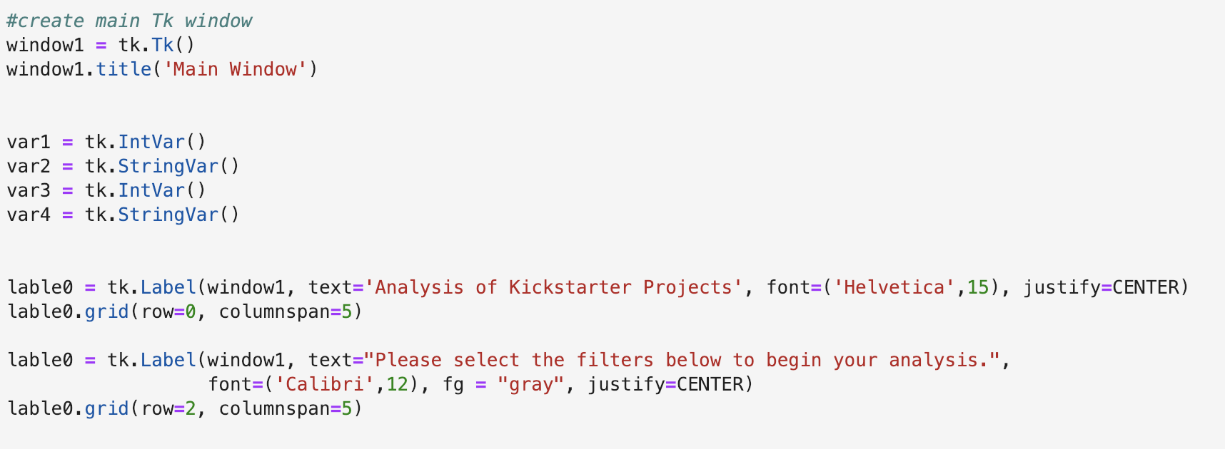
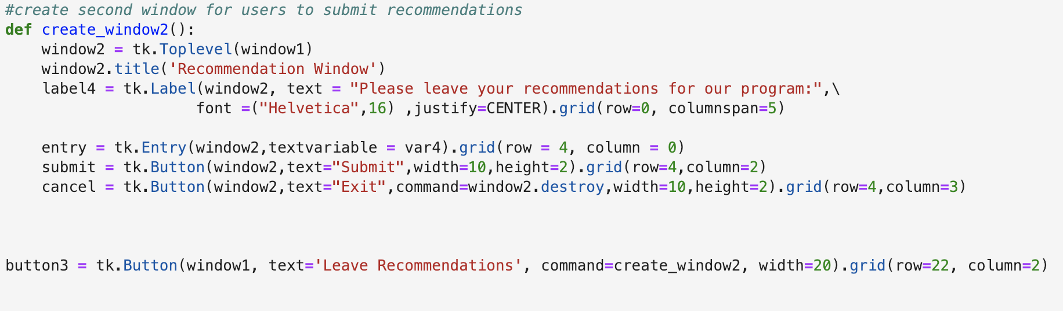
User Interface
We have created two windows for our project:
The initial window is to show some statistical analysis results to users, and let them get a brief idea of which kinds of project are likely to win at Kickstarter.
The second window is to prompt users to leave recommendation messages for our program.

Slide 6
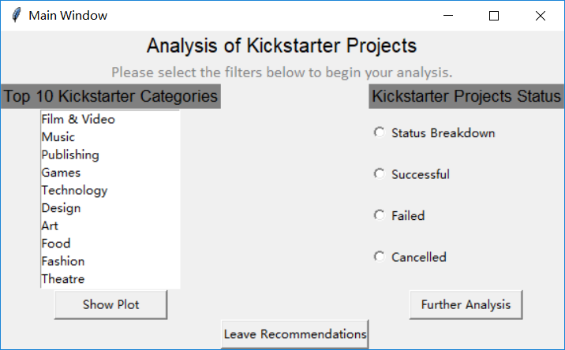
Main Window

Slide 7
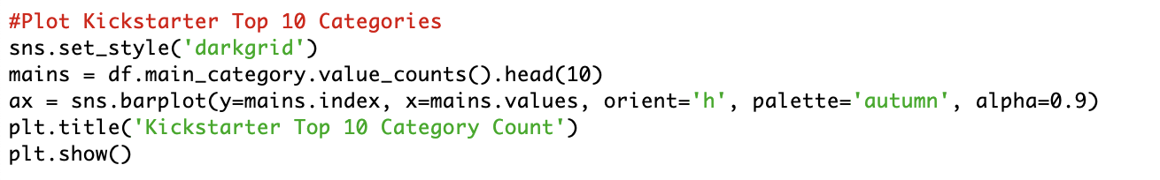
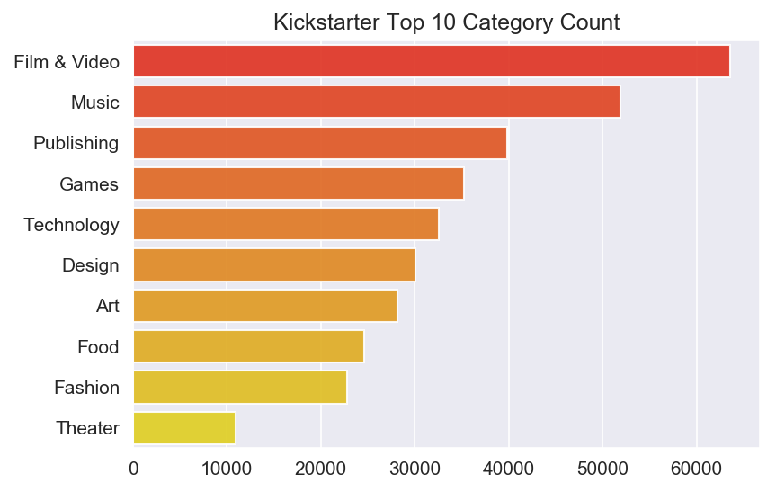
Most Frequent Category Type
Code:
Output:

Slide 8
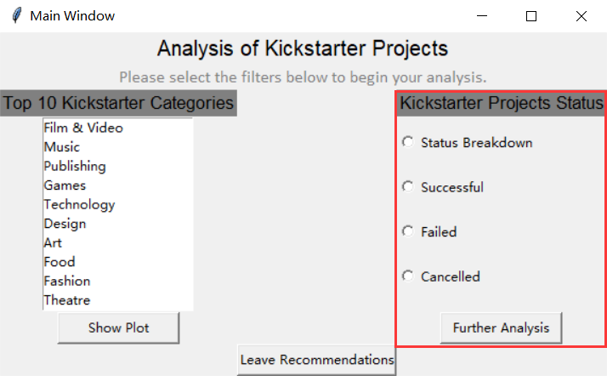
Kickstarter Project Status

Slide 9
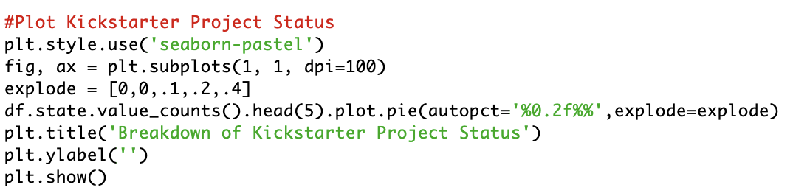
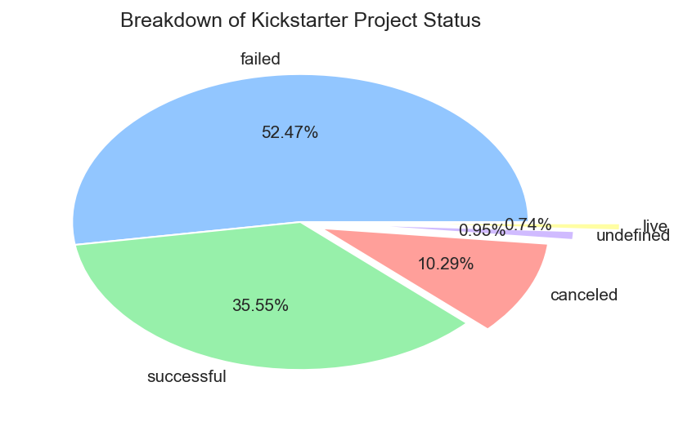
Project Status Breakdown
Code:
Output:

Slide 10
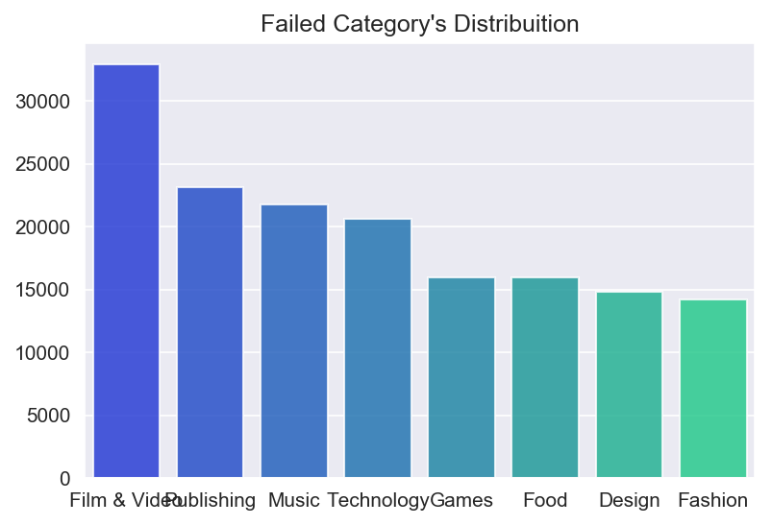
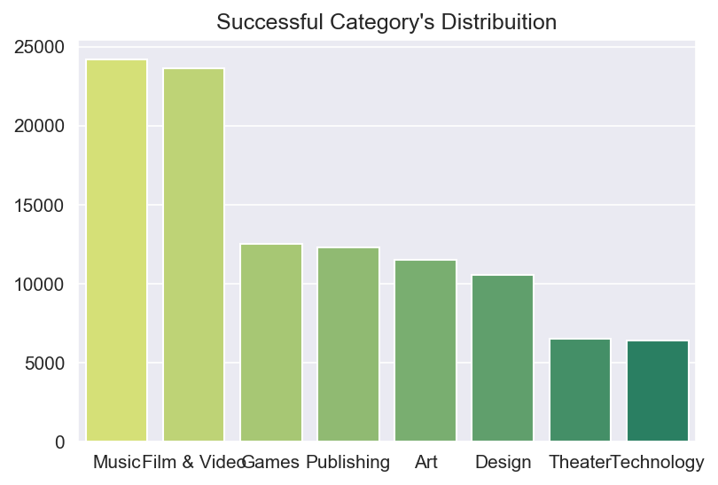
Frequency Distribution
Code:
Output:

Slide 11
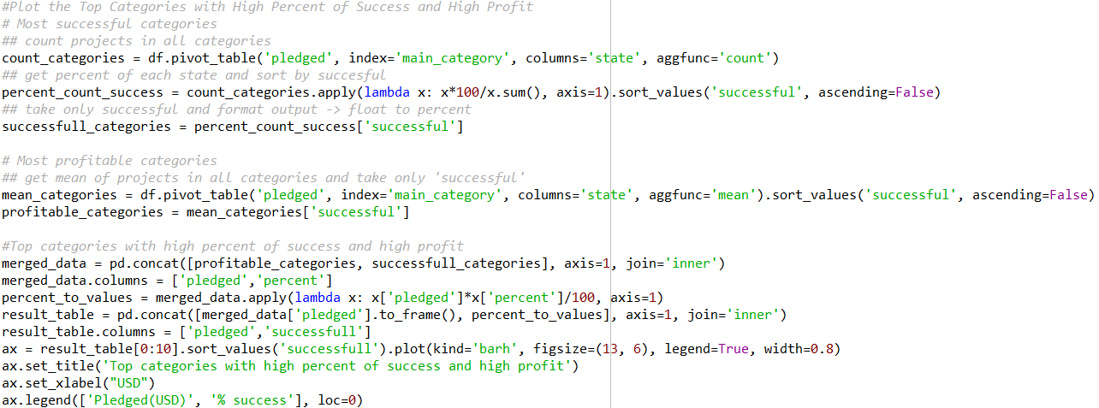
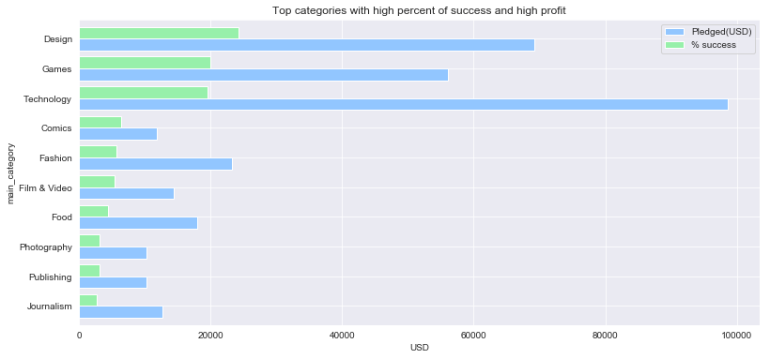
Top Categories with High Percent of Success and High Profit
Code:
Output:

Slide 12
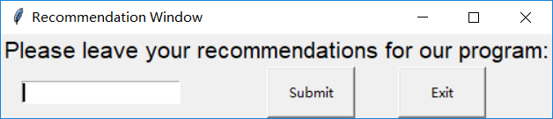
Window 2

Slide 13
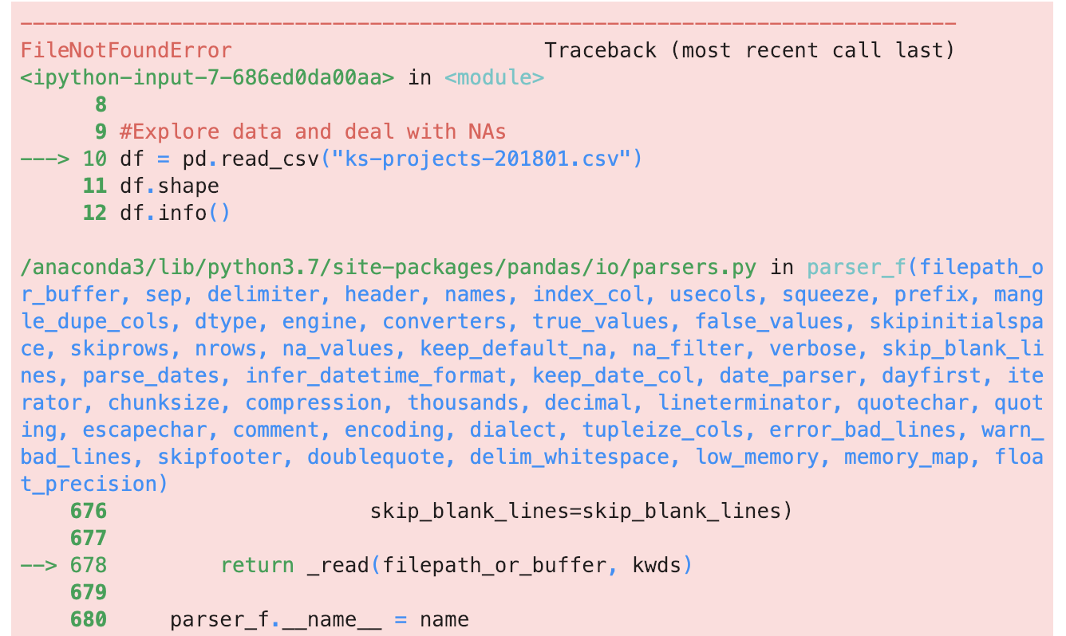
Challenges & Areas for Improvement
A few of the main things the major challenges encountered in this code were:
Initially attaching the data to the Tkinter buttons
Getting the program to provide summary statistics
Transferring the initial inputs in Window 1 to Window 2
Originally used both windows to filter on data for analyses
Storing user feedback

Slide 14
Areas for Improvement
Granularity
Allow users to analyze data on more granular level (by year, category, size of kickstarter)
Would help groups looking to plan and execute a kickstarter project
User Feedback
Store user feedback into the program for developers to reference
Predictive Modeling
Allow users to use statistical models to predict which kickstarters are more or less likely to fail based on given criteria
More advanced graphs
Live Databases
Allow users to connect program to live databases such as Oracle or Access

Slide 15
Code Demonstration
Notes:
If we want,

Slide 16
Questions?

